Slide 1
Managing the risk of those who present a risk of harm, in a church context
Julie O’Hara
Deputy Director – Development
National Safeguarding Team
Notes:
Introduce self and professional background.
Provide an overview of the 45 minute session and a health warning to take care of self!

Slide 2
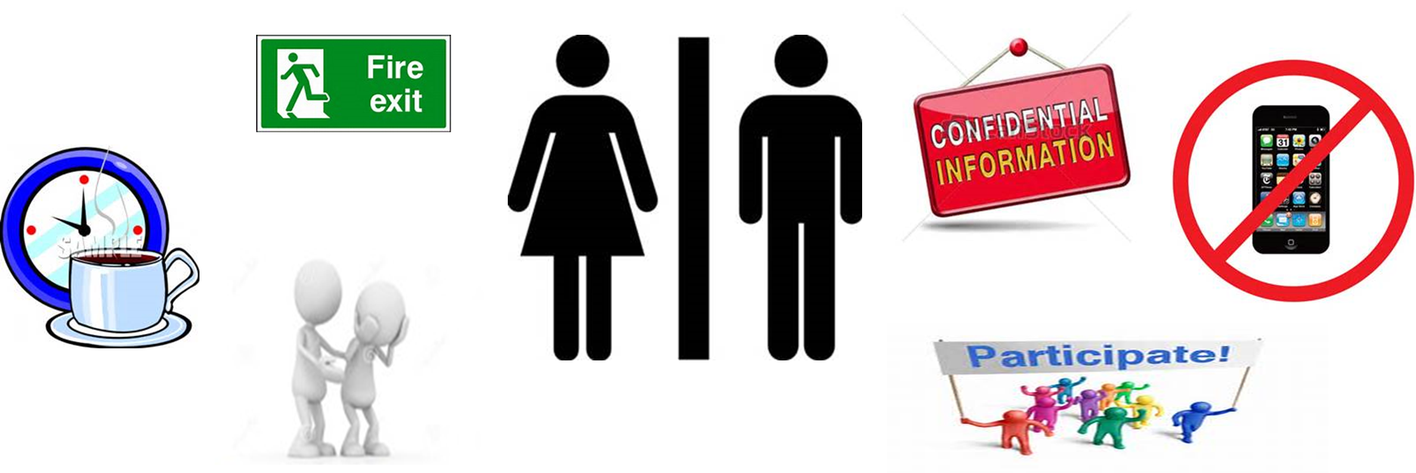
Housekeeping
Notes:
Also add the values we will hold today:
Participate with respect for the contribution of others
Value the diversity of each other
Use the content to stimulate learning during and beyond the sessions
Hold confidential any experiences you may hear or recognise today
Care for yourself and your needs during this time

Slide 3
Aims of today
By the end of today's workshop, you will be able to:
Articulate what risk of harm means and why it is important that you understand the risk someone presents to you and others;
Talk about your fears and recognise that these are normal feelings, and that it is ok to share with your Diocesan Safeguarding Team;
Understand that a good safeguarding culture helps us to manage risk of harm.

Slide 4
Risk in the church context
“Safeguarding is everyone’s business. For faith-based organisations and communities, getting this right can be challenging but it must be at the heart of everything they do. Recognising the risks and understanding that abusers can hide in plain sight is more than a tick-box exercise, it’s about culture and behaviour.”
Paul Burstow, Chair, SCIE
Notes:
The context for risk assessment is to make Church communities safe for all who participate in them. The purpose is to assess, or to contribute to the assessment of, risks of harm to children and/or adults that may be presented by the subject of the information shared, in the context of the Church body of which the subject is a member or wishes to join, considering his or her specific roles, and the ability of the community to manage such risks.

Slide 5
Why do we allow people who present a risk of harm to worship?
The House of Bishops’ Safeguarding Policy 2017 states:
  “The Church, based on the message of the gospel, opens its doors to all. It will therefore endeavour to offer pastoral care and support to any member of the church community who may present a known risk.”

Slide 6
What does risk of harm mean?
Question: What does risk of harm mean to you?
Definition (Generic): A source or situation with the potential for harm in terms of human injury, ill health. Damage to property, financial loss, or impact on over all well being, or a combination of these.
Definition (Legal) Risk of harm means a significant danger that a child/vulnerable adult will suffer serious harm other than by accidental means, which harm would be likely to cause physical injury, neglect, emotional maltreatment or sexual abuse.
Question: What are your fears?
Notes:
Ask people to shout out what they think risk of harm is? Flip chart responses.
Provide definition making it clear that there is no church specific definition – so here are two examples. Common theme is physical, sexual, emotional harm – first definition extends into the other areas which includes financial etc.
Ask people what fears they have in relation to people who may present a risk of harm being in the community?

Slide 7
How do we manage risk of harm?
Refer to your Diocesan Safeguarding Team (remember risk of harm is not always those with a conviction);
DSA will:
  Meet with the person
  Gather information from them, yourselves and partner agencies to make an assessment of risk in a church context.
  Prepare a Safety Plan (if appropriate) and share this with the person, PSO, Incumbent and Reference Group Members;
Managing risk is also about the environment ensuring that there is a good safeguarding culture in your parish.
Notes:
Each assessment helps to achieve the following:
The identification of risks of harm to children, young people or vulnerable adults in the context of the likely scenarios for their future involvement in Church communities.
How risks may be addressed or managed and what safety would look like for individual children, young people or vulnerable adults.
Create a shared understanding and common approach by those with safeguarding responsibilities to the management and reduction of risk.
Develop a plan which seeks to ensure the safety of children, young people and vulnerable adults, and to address the safety of the person who presents a risk.

Slide 8
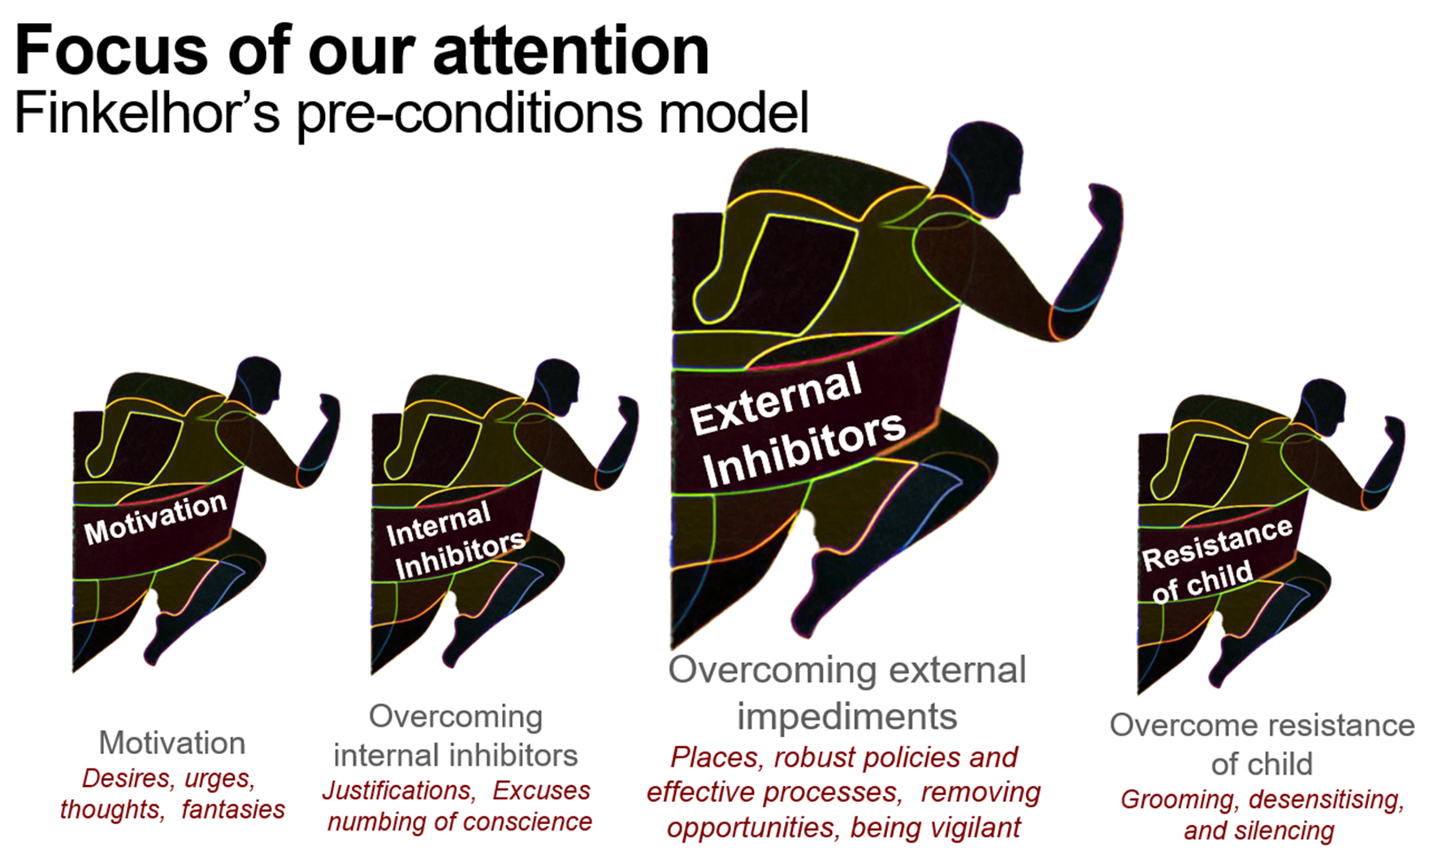
Why is a safe environment important?
Notes:
Explain Finklehor – but only focus on the external inhibitors as the point in which we have a role.

Slide 9
Case scenarios
With the people either side of you (groups of 3-4), read the scenario and discuss:
  What is the risk of harm?
  What steps should you take?
  What will happen next?
  What is your parish doing or could do to improve the safeguarding culture?
You have 10 minutes to discuss and then we will feedback as a group.

Slide 10
Any Questions?

