Slide 1
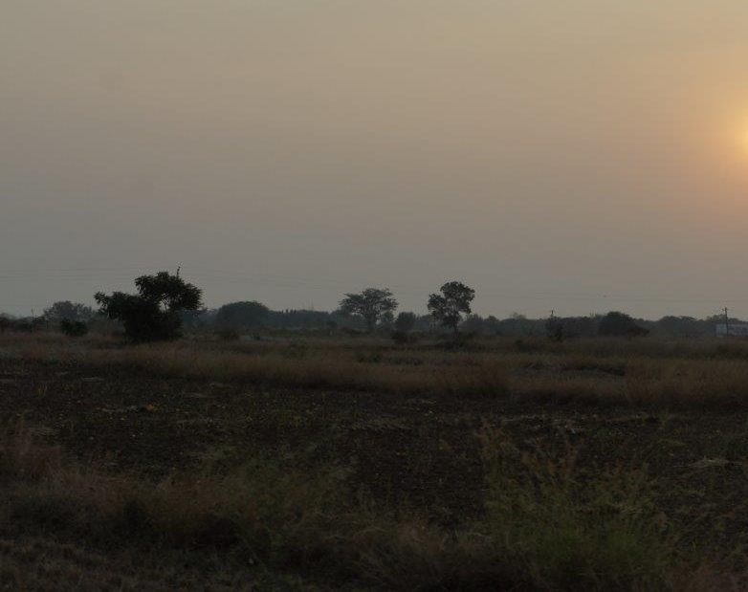
Time of Prayer for India and our partners in Nandyal
Time to still ourselves …

Slide 2
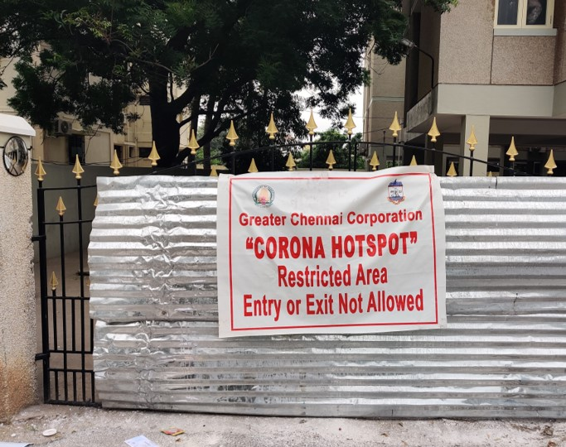
Pray for all in India suffering because of COVID-19
Photo by Govind Krishnan on Unsplash

Slide 3
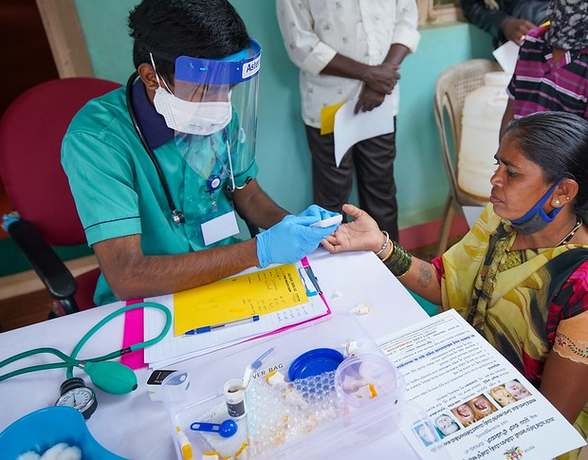
Pray for all working on the front lines of healthcare …
Trinity Care Foundation, Fight Against COVID-19 @ Jangamakote Village. Creative Commons License, sourced on Flickr

Slide 4


Pray for the Church throughout India

Slide 5
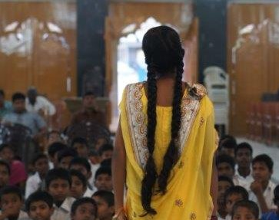
Pray for the Diocese of Nandyal

Slide 6
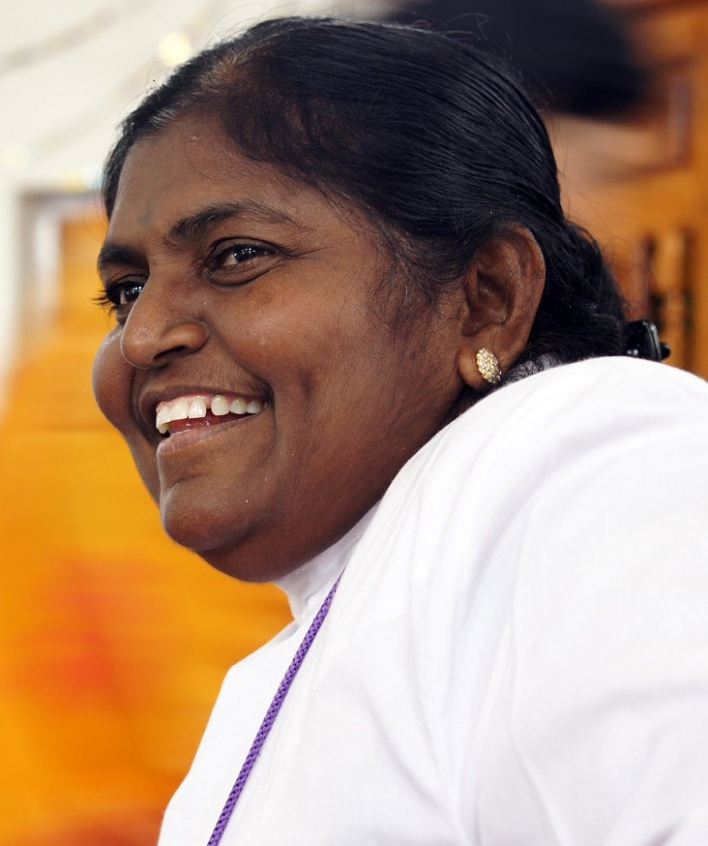
Pray that we may know how best to stand alongside our brothers and sisters

