Slide 1
Income During a Cost of Living Crisis
Joshua Townson
Generous Giving Adviser

Slide 2
Where are we?
Notes:
2

Slide 3
Decreased income
Increased costs
Anxiety and fatigue

Slide 4
The symptoms
A drift towards small-scale fundraising
A lot of activity for limited reward
A separation between missional & financial planning

Slide 5
What can we do
A renewed focus on “giving”
Invitational approach
Allow mission & finances to inform each other

Slide 6
Why giving and not fundraising?
Notes:
6

Slide 7
Finding grants will only get harder and is mostly limited to projects
Fundraising is financially unsustainable as a source of regular income
Giving increases long-term engagement

Slide 8
What can we get grants for?
Projects
Historic buildings
Secular community projects
Community use of buildings

Slide 9
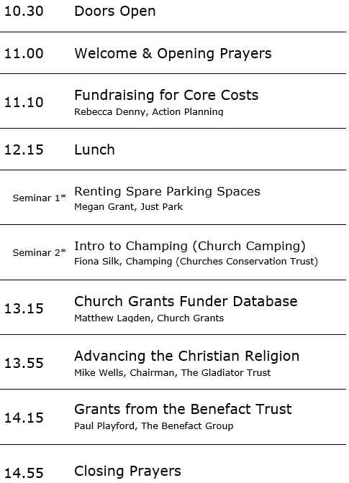
Fundraising Training Event
20th May
High Wycombe

Slide 10
How do we engage people with giving?
Notes:
10

Slide 11
Vision
Impact
Participation
Notes:
11

Slide 12
Motivation in a church context
Regular worshippers
Irregular worshippers & electoral roll
Attendants at regular non-worship groups/events
Attendants at Christmas/Easter/Remembrance
Those married or christened at the church
Attendees at occasional non-worship events
Local residents with no relationship
Congregants
Non-Congregants /
Existing relationship
Local community
Notes:
12

Slide 13
Christian Mission
Worship Life
Community-focused charity &
building
Congregants
Non-Congregants
Local Community
Notes:
13

Slide 14
And they came, everyone whose heart was stirred, and everyone whose spirit was willing, and brought the Lord’s offering to be used for the tabernacle and for all its service.
Exodus 35.21

Slide 15
Vision
Start with your mission
Impact
Give people a reason
Participation
Invite them in
Notes:
15

Slide 16
Next steps…
Notes:
16

Slide 17
Take some time to think about
Bringing mission & finance together
Your impact
How can you invite people in

