Slide 1
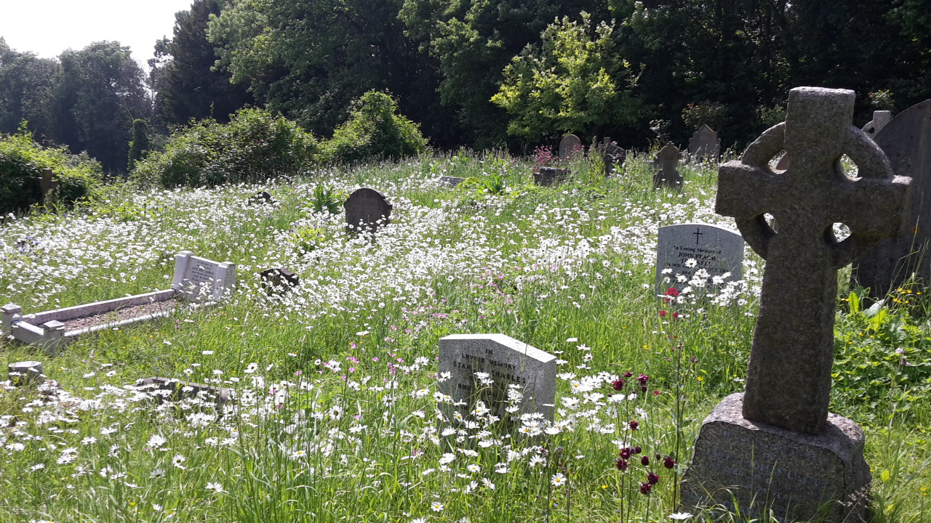
Caring for Creation
during a cost-of-living crisis
Hannah Mann
Environment Programme Manager
Notes:
Acting on environmental and climate issues is a matter of justice and of care for our global neighbours, as those who have done least to cause the problems are suffering the worst effects. God also asks us to look after the world he’s given us. Next week is Loss and Damage Action Day, headed up by Faith for the Climate. This is all about highlighting the cost to poorer countries of climate impacts. Pakistan droughts have cost £8.5b but their contribution to global emissions is about 1%
Jo Chamberlain from the CofE Environment Programme says:
“As people who are called to bring hope, to be kingdom builders, and to love God and neighbour, any action to reduce our carbon footprint is an expression of our Christian discipleship.”
The latest IPCC (Intergovernmental Panel on Climate Change) report at the end of February this year highlighted the need for urgent action. In February 2020 the CofE agreed a target of reaching Net Zero carbon (meaning we are no longer contributing to climate change) by 2030. Oxford Diocese also has its own, broader, 2035 net zero carbon target.

Slide 2
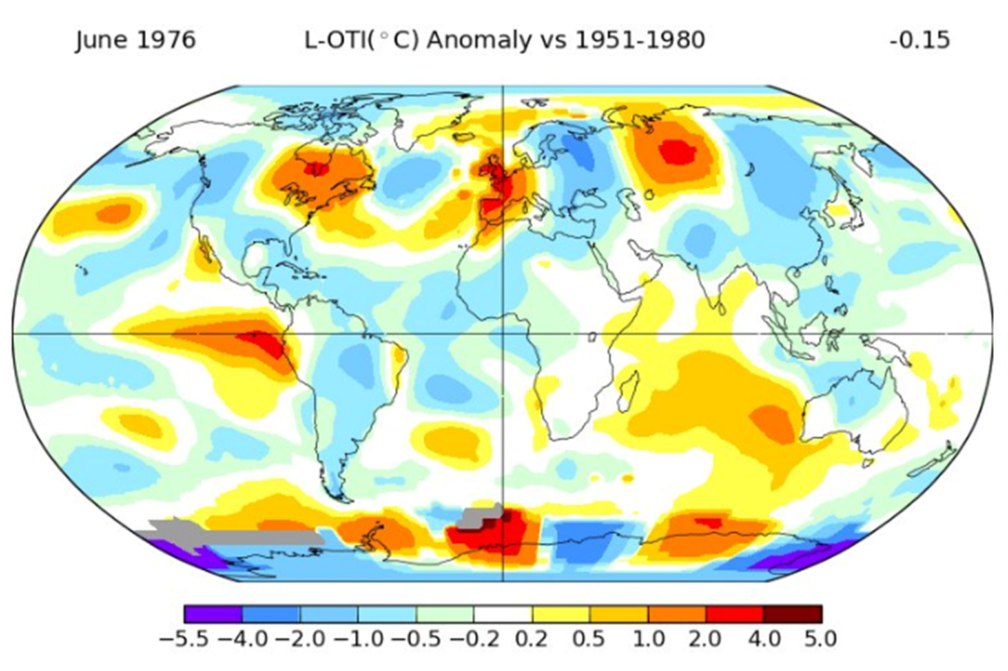
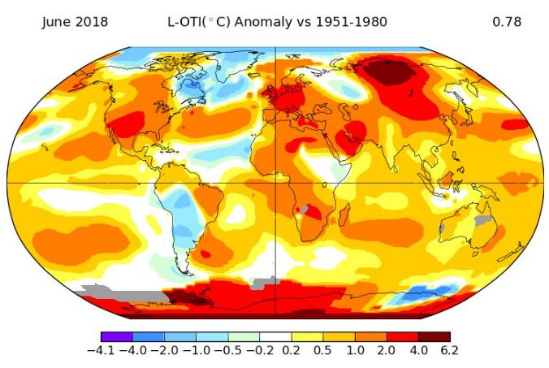
Why are we here?
The warmest seven years on record have all been since 2015
This July (2022) saw the highest ever temperature recorded in the UK, and has been the driest July on record
Notes:
We are here because there is a climate and ecological emergency
The warmest seven years on record have all been since 2015, the recent heatwaves will become much more common, and more like 'weather' than heatwaves
Our carbon emissions need to peak in the next three years if we are to avoid catastrophic climate change
Earth overshoot day was on 28th July this year – marks the date when humanity’s demand for ecological resources and services in a given year exceeds what Earth can regenerate in that year. The current political will to act is limited, little has been said from either leader on climate issues prior to announcement of new PM. As a church we have a role to pray, act and advocate.

Slide 3
Climate crisis – so what?
The Five Marks of Mission
To proclaim the good news of the kingdom
To strive to safeguard the integrity of creation, and sustain and renew the life of the earth
To teach, baptise and nurture new believers
“Responding to climate change is an essential part of our responsibility to safeguard God’s creation”
Justin Welby, Archbishop of Canterbury
To seek to transform unjust structures of society
To respond to human need by loving service
Notes:
Acting on environmental and climate issues is a matter of justice and of care for our global neighbours, as those who have done least to cause the problems are suffering the worst effects. God also asks us to look after the world he’s given us. Next week is Loss and Damage Action Day, headed up by Faith for the Climate. This is all about highlighting the cost to poorer countries of climate impacts. Pakistan droughts have cost £8.5b but their contribution to global emissions is about 1%
Jo Chamberlain from the CofE Environment Programme says:
“As people who are called to bring hope, to be kingdom builders, and to love God and neighbour, any action to reduce our carbon footprint is an expression of our Christian discipleship.”
The latest IPCC (Intergovernmental Panel on Climate Change) report at the end of February this year highlighted the need for urgent action. In February 2020 the CofE agreed a target of reaching Net Zero carbon (meaning we are no longer contributing to climate change) by 2030. Oxford Diocese also has its own, broader, 2035 net zero carbon target.

Slide 4
Celebrating ALL of creation in:
Worship – our Christian response to creation care
Land & nature – churchyards and church gardens
Buildings – energy, resources, procurement
Lifestyle – supporting our congregations make choices
Advocacy – engaging in climate justice
Notes:
Acting on environmental and climate issues is a matter of justice and of care for our global neighbours, as those who have done least to cause the problems are suffering the worst effects. God also asks us to look after the world he’s given us. Next week is Loss and Damage Action Day, headed up by Faith for the Climate. This is all about highlighting the cost to poorer countries of climate impacts. Pakistan droughts have cost £8.5b but their contribution to global emissions is about 1%
Jo Chamberlain from the CofE Environment Programme says:
“As people who are called to bring hope, to be kingdom builders, and to love God and neighbour, any action to reduce our carbon footprint is an expression of our Christian discipleship.”
The latest IPCC (Intergovernmental Panel on Climate Change) report at the end of February this year highlighted the need for urgent action. In February 2020 the CofE agreed a target of reaching Net Zero carbon (meaning we are no longer contributing to climate change) by 2030. Oxford Diocese also has its own, broader, 2035 net zero carbon target.

Slide 5
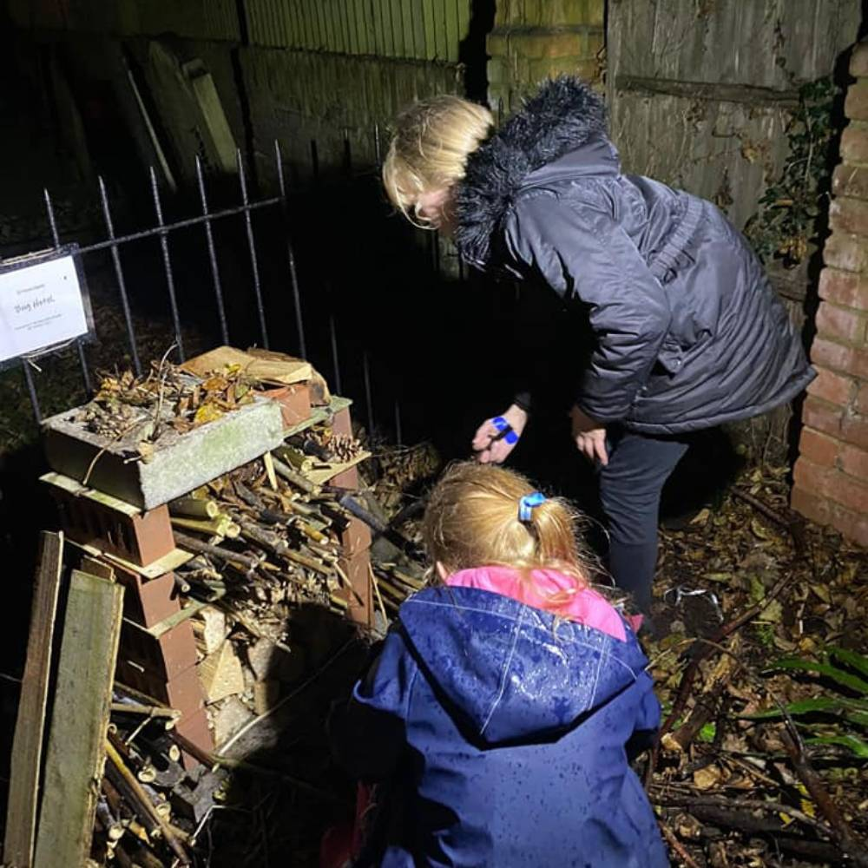
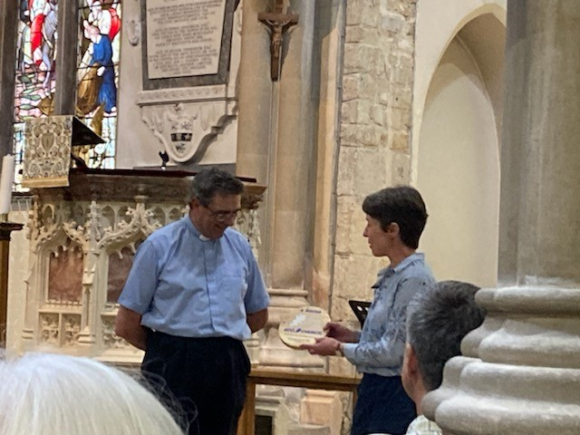
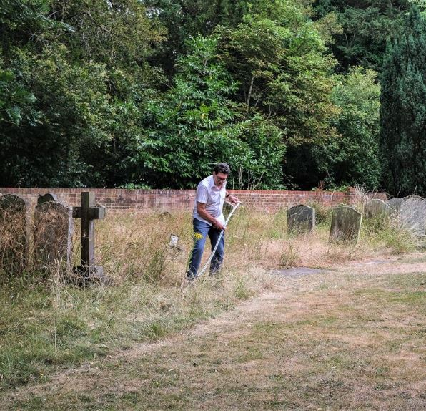
Eco Churches in Action…
Need support?
New Eco Hub – access via Diocesan website
Equipping Churches for Creation Care – Area events 3-17 June 2023
Greenshoots Network – email Environment Team to join
Notes:
Acting on environmental and climate issues is a matter of justice and of care for our global neighbours, as those who have done least to cause the problems are suffering the worst effects. God also asks us to look after the world he’s given us. Next week is Loss and Damage Action Day, headed up by Faith for the Climate. This is all about highlighting the cost to poorer countries of climate impacts. Pakistan droughts have cost £8.5b but their contribution to global emissions is about 1%
Jo Chamberlain from the CofE Environment Programme says:
“As people who are called to bring hope, to be kingdom builders, and to love God and neighbour, any action to reduce our carbon footprint is an expression of our Christian discipleship.”
The latest IPCC (Intergovernmental Panel on Climate Change) report at the end of February this year highlighted the need for urgent action. In February 2020 the CofE agreed a target of reaching Net Zero carbon (meaning we are no longer contributing to climate change) by 2030. Oxford Diocese also has its own, broader, 2035 net zero carbon target.

Slide 6
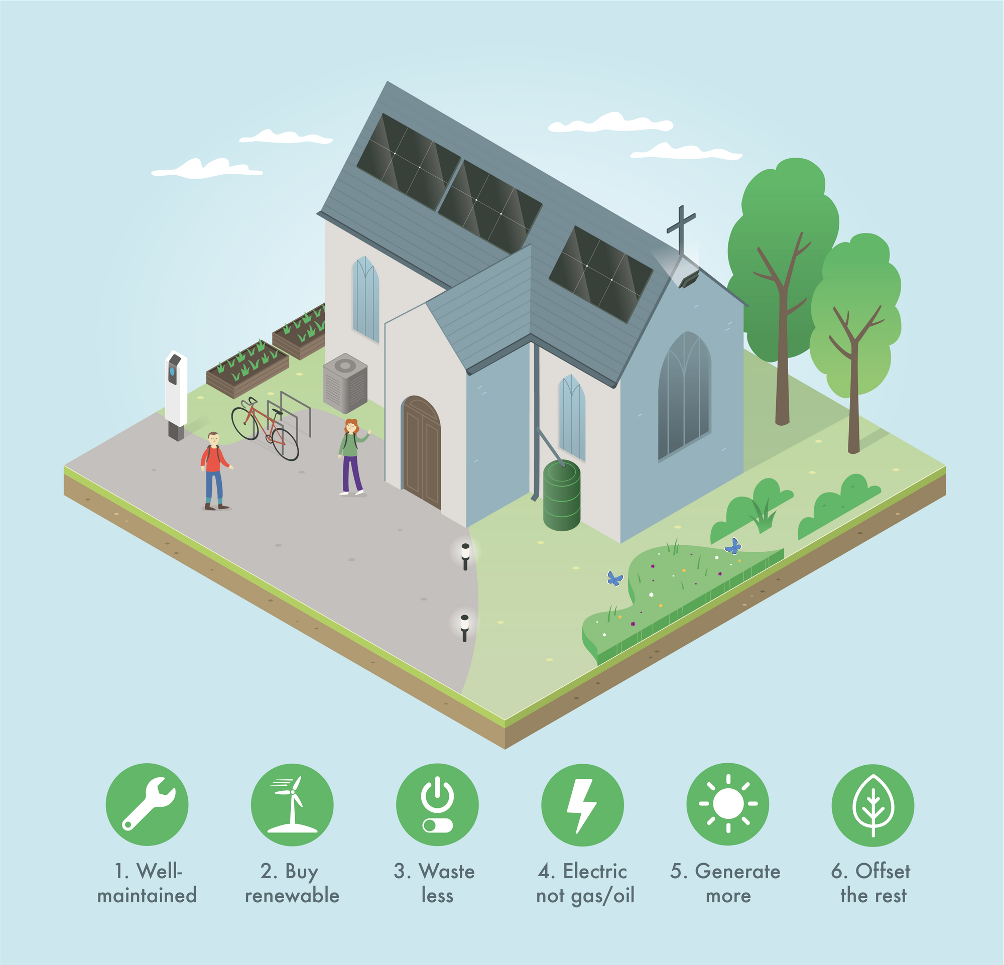
Saving energy and a journey to net zero
Measuring and monitoring (EFT!)
Practical Path to Net Zero
Energy Efficiency checklist, parish resources
Energy audit
Action plan that fulfils the mission and vision of the church
Larger church? Join our support network!
Notes:
Acting on environmental and climate issues is a matter of justice and of care for our global neighbours, as those who have done least to cause the problems are suffering the worst effects. God also asks us to look after the world he’s given us. Next week is Loss and Damage Action Day, headed up by Faith for the Climate. This is all about highlighting the cost to poorer countries of climate impacts. Pakistan droughts have cost £8.5b but their contribution to global emissions is about 1%
Jo Chamberlain from the CofE Environment Programme says:
“As people who are called to bring hope, to be kingdom builders, and to love God and neighbour, any action to reduce our carbon footprint is an expression of our Christian discipleship.”
The latest IPCC (Intergovernmental Panel on Climate Change) report at the end of February this year highlighted the need for urgent action. In February 2020 the CofE agreed a target of reaching Net Zero carbon (meaning we are no longer contributing to climate change) by 2030. Oxford Diocese also has its own, broader, 2035 net zero carbon target.

Slide 7
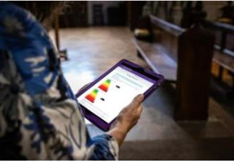
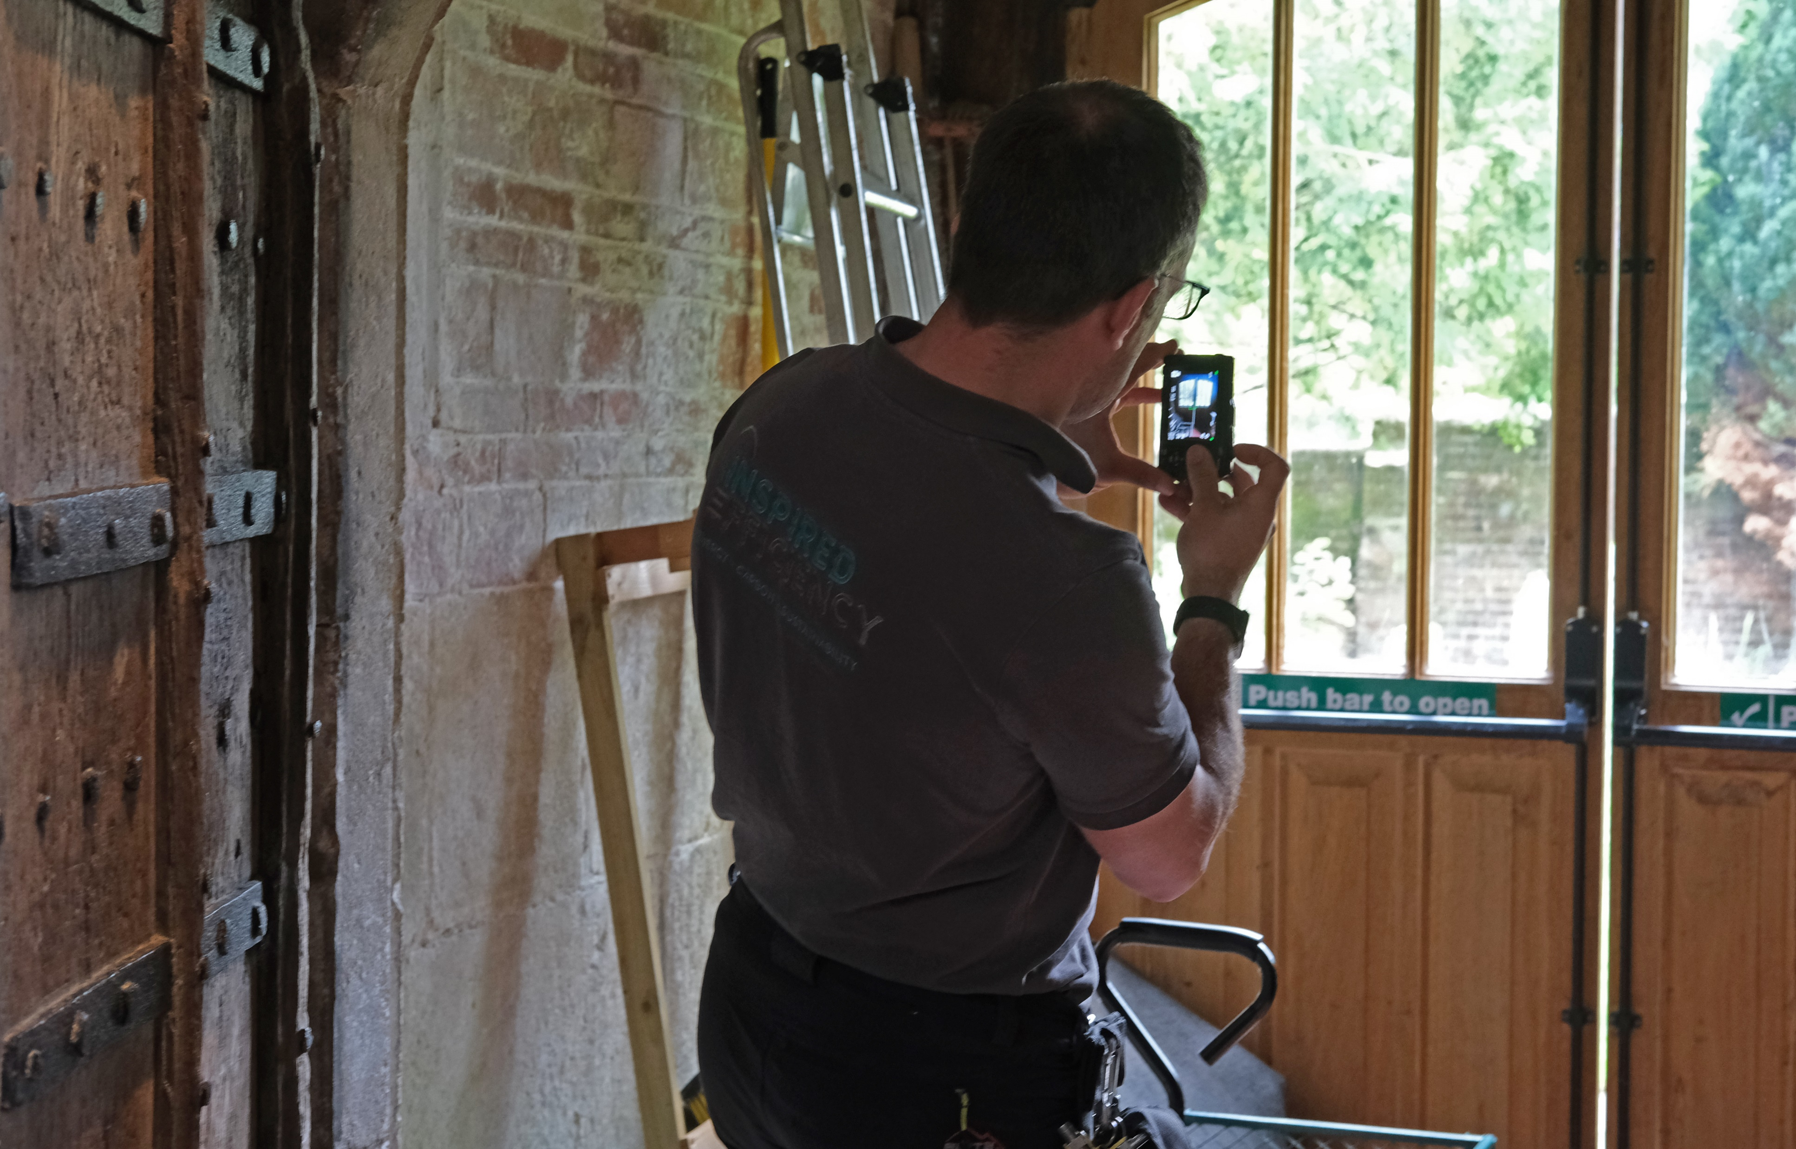
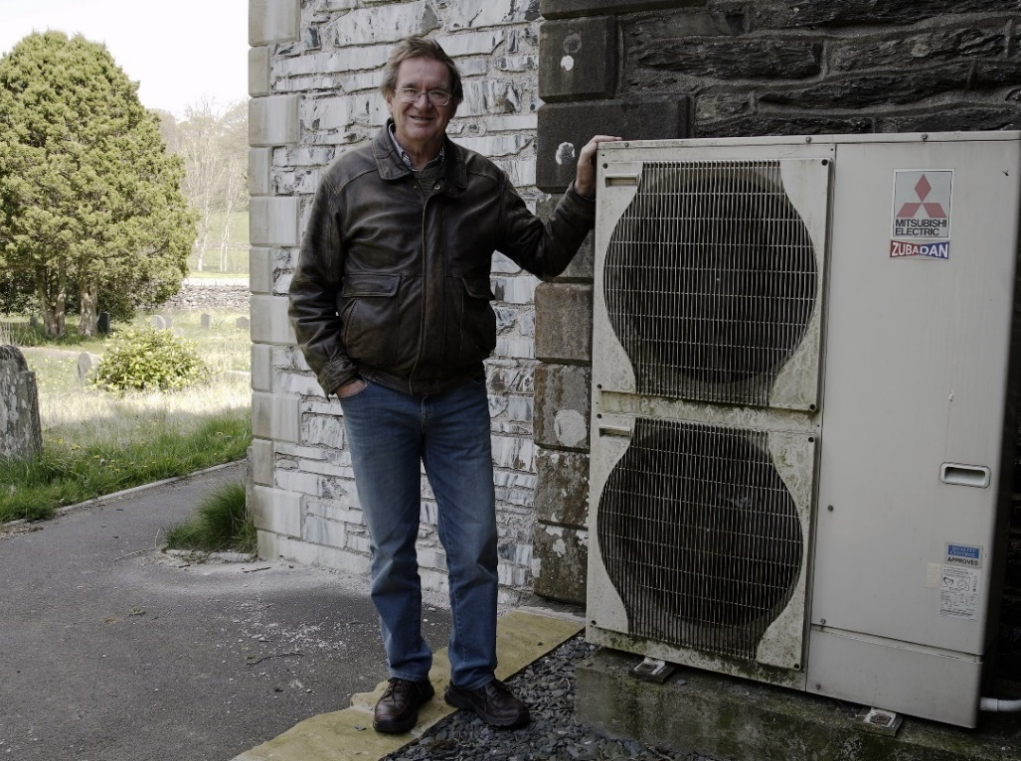
The boiler is broken!
Heat resilience planning
Faculty rule changes, due regard and thinking long-term
Technical solutions, ‘bridging’ options
Funding challenges
A positive opportunity
Notes:
Acting on environmental and climate issues is a matter of justice and of care for our global neighbours, as those who have done least to cause the problems are suffering the worst effects. God also asks us to look after the world he’s given us. Next week is Loss and Damage Action Day, headed up by Faith for the Climate. This is all about highlighting the cost to poorer countries of climate impacts. Pakistan droughts have cost £8.5b but their contribution to global emissions is about 1%
Jo Chamberlain from the CofE Environment Programme says:
“As people who are called to bring hope, to be kingdom builders, and to love God and neighbour, any action to reduce our carbon footprint is an expression of our Christian discipleship.”
The latest IPCC (Intergovernmental Panel on Climate Change) report at the end of February this year highlighted the need for urgent action. In February 2020 the CofE agreed a target of reaching Net Zero carbon (meaning we are no longer contributing to climate change) by 2030. Oxford Diocese also has its own, broader, 2035 net zero carbon target.

Slide 8
Hannah.mann@oxford.anglican.org
environment@oxford.anglican.org
Greenshoots Network | Diocese of Oxford | Facebook
Notes:
Acting on environmental and climate issues is a matter of justice and of care for our global neighbours, as those who have done least to cause the problems are suffering the worst effects. God also asks us to look after the world he’s given us. Next week is Loss and Damage Action Day, headed up by Faith for the Climate. This is all about highlighting the cost to poorer countries of climate impacts. Pakistan droughts have cost £8.5b but their contribution to global emissions is about 1%
Jo Chamberlain from the CofE Environment Programme says:
“As people who are called to bring hope, to be kingdom builders, and to love God and neighbour, any action to reduce our carbon footprint is an expression of our Christian discipleship.”
The latest IPCC (Intergovernmental Panel on Climate Change) report at the end of February this year highlighted the need for urgent action. In February 2020 the CofE agreed a target of reaching Net Zero carbon (meaning we are no longer contributing to climate change) by 2030. Oxford Diocese also has its own, broader, 2035 net zero carbon target.

