Slide 1






a more Christ-like Church
for the sake of God’s world
contemplative | compassionate |courageous

Slide 2
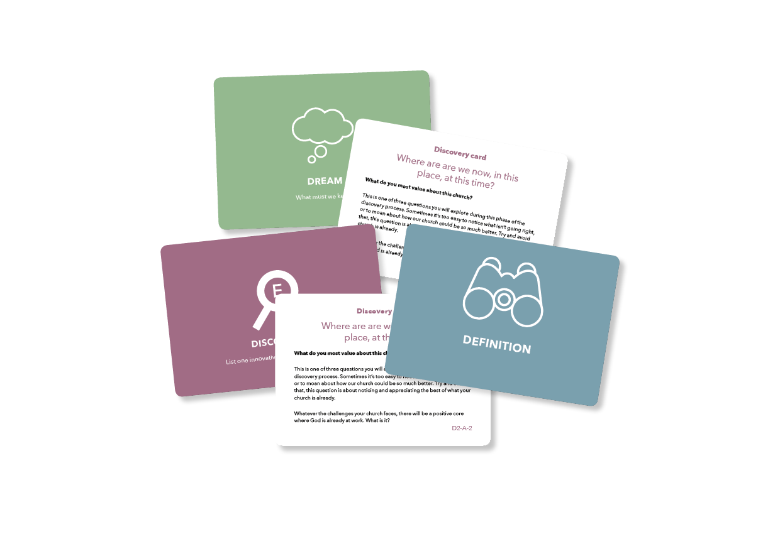

The parish planning tool
Supports the mission of your church to become more Christ-like
Helps you to see where God is at work and join in
Uncovers the things that work in your context and carry them forward in new and transformed ways.
“Every church becomes a place of hope
and confidence in God and in themselves”

Slide 3
We believe that
Every church, group or community has something positive at its heart.
Churches have more confidence and are better equipped for the journey if they carry with them something from their shared past…
… but the past should have life. It should not be dry bones.
Carefully framed questions can shift our thinking and release change.
The language we use/the things we focus on can free or restrict our thoughts.
Everyone experiences things in different ways. Differences need to be heard and valued.

Slide 4
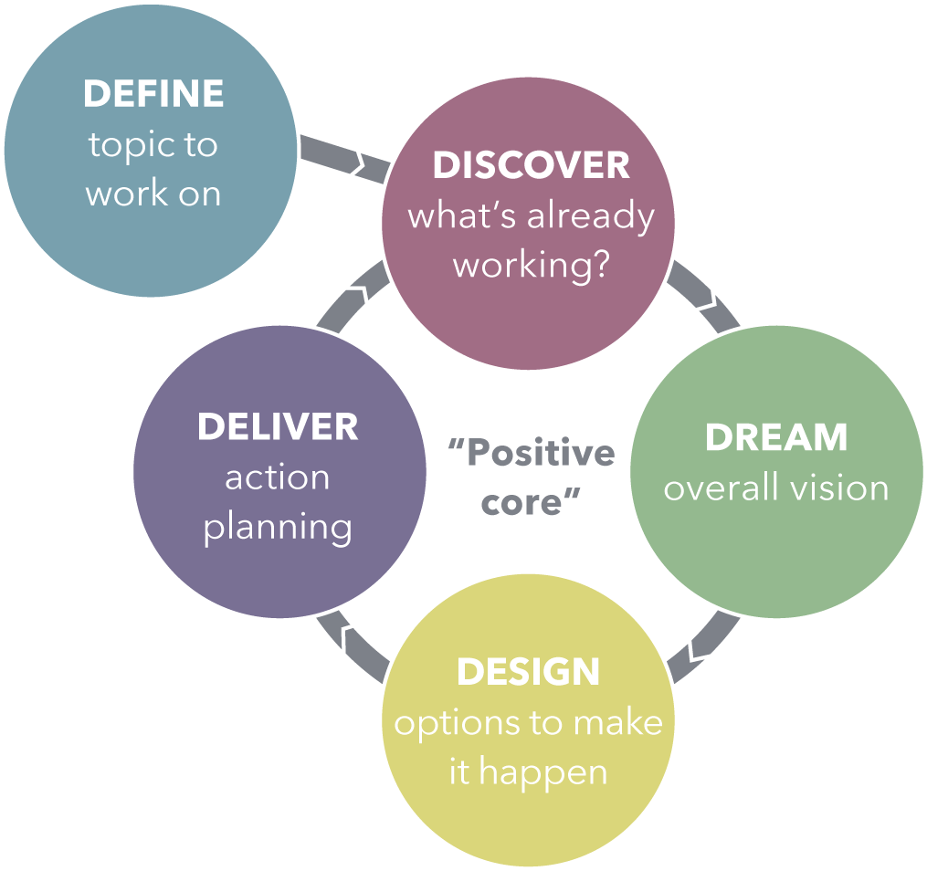
Appreciative inquiry

Slide 5
God has a calling for your church
Every church has its strengths, achievements, opportunities, green shoots of potential and resources.
Your church has its own important story to tell (and be reminded of).
So let’s begin with the premise that you are where you are; that God has a vision for the future of your church in the unfolding of His kingdom of love and healing of the world, where you are.
“Your church is not a problem that needs fixing.”

