Slide 1
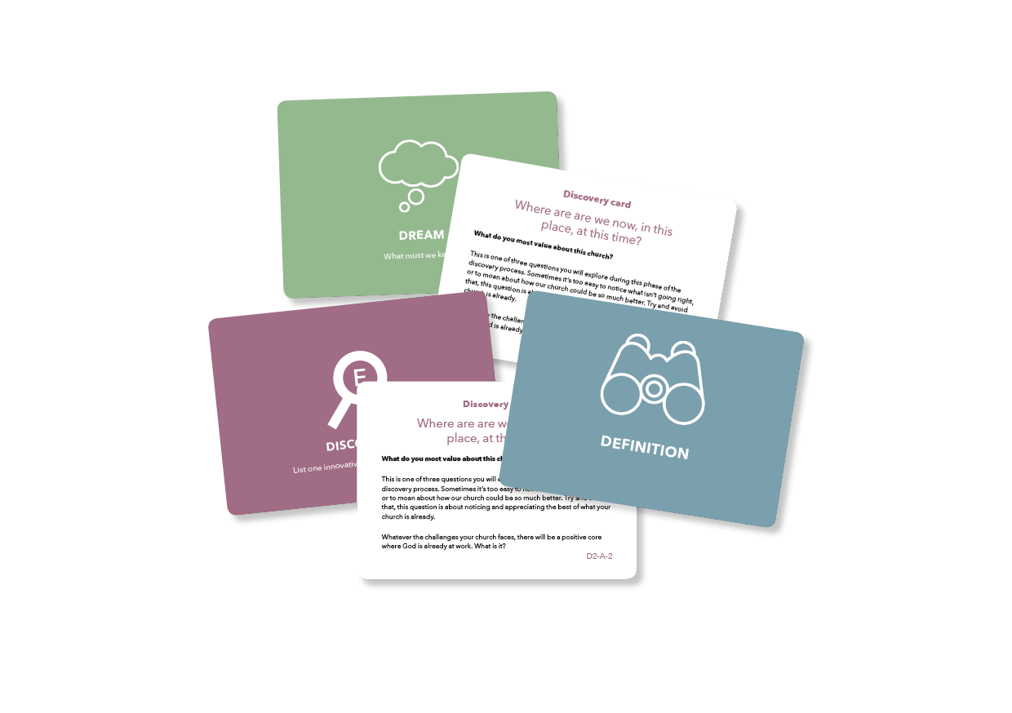
COPYRIGHT NOTICE
All slides & contents © Diocese of Oxford. Please do not adapt or alter this slide deck.
This presentation is only for users of the Parish Planning Tool (PPT) pack and in conjunction with the PPT process. Churches outside the Diocese of Oxford and others wishing to use the Parish Planning Tool should first contact
communications@oxford.anglican.org

