Slide 1
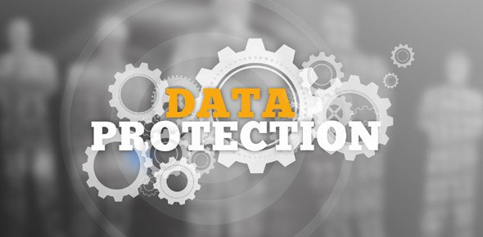


GDPR for Parishes and Deaneries
November 2018
v2.0 15NOV18
1

Slide 2
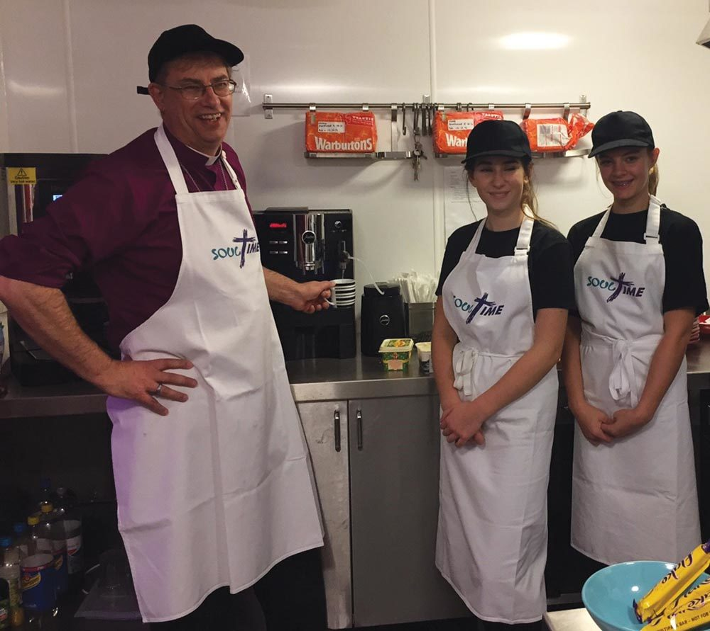
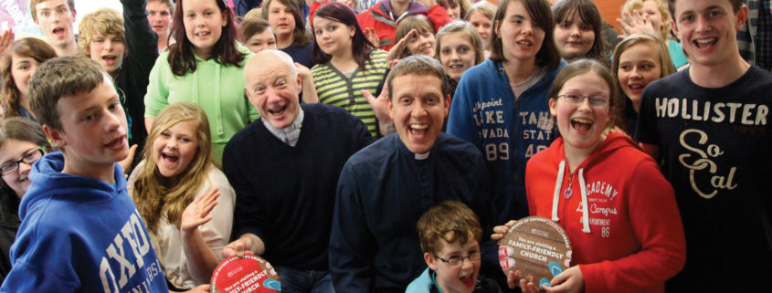
GDPR: Your area of interest
Parish
Benefice
Deanery
Other – charity, chaplaincy, school, etc.
2

Slide 3
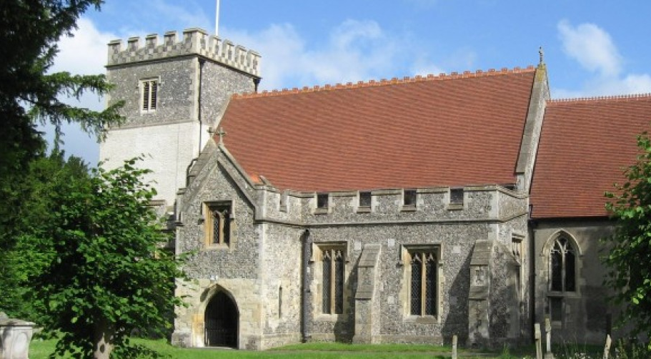
GDPR: where is your parish/benefice/deanery?
Not started yet
At the planning stage
Some steps taken (for example, Privacy Notice published)
Most areas of parish activity are GDPR compliant
All areas are GDPR compliant
3

Slide 4
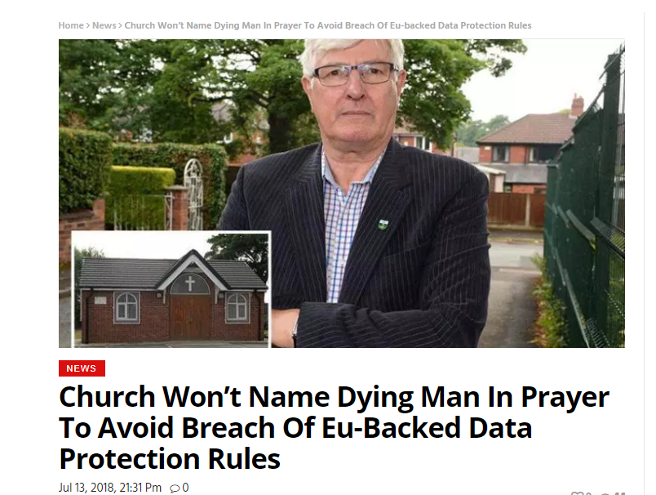
GDPR: Important, but don’t over-react
4

Slide 5

Interpreting the law
5

Slide 6
Interpreting the law
Personal data is
“information that relates to an … identifiable individual”
John Smith
in St Paul’s PCC?
in Oxford?
in Berkshire?
6

Slide 7
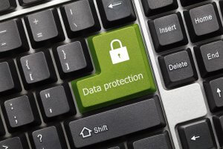

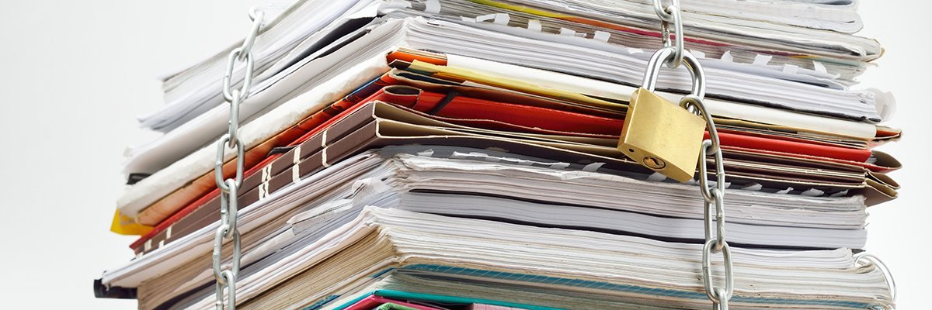

In this session
About GDPR: definitions
GDPR: key concepts
Journey to Compliance
means internet search terms
7

Slide 8
About GDPR: Definitions
8

Slide 9
General Data Protection Regulation (GDPR)
Data Protection is about avoiding harm to individuals by misusing or mismanaging their personal data.
GDPR is:
An extension/tightening of existing data protection legislation (DPA 1998)
UK data protection law is now a combination of:
  EU General Data Protection Regulation 2016/679 (the “GDPR”)
  UK Data Protection Act 2018 (the “DPA 2018”)
  All generally referred to as “GDPR”.
9
Notes:
For (mainly) a breach of record keeping, contracting and security clauses
maximum fine of up to €10 million, or 2% of annual worldwide turnover, whichever is greater
For (mainly) a breach of the basic principles, Data Subject rights, transfer to third countries, non-compliance with an EU DPA order
maximum fine of up to €20 million, or 4% of annual worldwide turnover, whichever is greater

Slide 10

Personal Data
Personal data is any information about a living individual, which is capable of identifying that individual:
on paper as well as digital/electronic
images as well as text (e.g. photos, CCTV)
don’t forget indirect
Sensitive Personal data is any information relating to an individual’s
Racial or ethnic origin
Sexual orientation
Religious, political or trade union affiliation
Genetic or biometric data
Known as ‘special category’ data.
NB Christian religious affiliation can be inferred for church members.
The Data Subject is the person about whom personal data is being processed
10

Slide 11


Data Controllers and Processors
Data Controller
The legal entity that decides how the data is kept and used
  (the data controller may also process data, also you can have joint controllers)
Data Processor
A different legal entity who is actually processing (using) the data, (on instructions from the data controller)
Recording, disseminating, adapting, obtaining, destroying, organising, erasing, transmitting, retrieving, combining, altering, holding …
… are ALL DATA PROCESSING
Watch out for different
legal entities: incumbents, PCCs, ODBF, ODBE, suppliers, etc.
11

Slide 12
A Glimpse of the Process…
12

Slide 13
Typical steps for parishes/deaneries:
Raise awareness
Conduct a Data Audit (and data mapping)
Identify (and document) your ‘lawful bases’
Check your processes meet the ‘eight rights’ and ‘seven principles’
Review how you get consent
Build in extra protection for children
Data retention and disposal
Review your Data Sharing
Update Policies & Privacy Notices
Work out how you will deal with Subject Access Requests
Data breaches: how will you detect, report and investigate?
Training
Build-in data protection to your new initiatives
rochester diocese gdpr toolkit
(simpler version at parishresources.org.uk/gdpr)
13

Slide 14
GDPR: Key Concepts
14

Slide 15
GDPR: Eight Rights of Individuals
Right to be Informed
Informed about the collection and use of their personal data (transparency)
Right of Access
(a.k.a. Subject Access Request) may be made verbally or in writing. One month to respond. No fee.
Right to rectification
Correcting inaccurate data
Right to erasure (right to be forgotten)
Right to restrict/suppress processing
In certain circumstances: store data but not use it.
Right to Data Portability
Ease of movement between IT environments
Right to Object
Absolute right with regard to direct marketing
Rights in relation to automated decision-making and profiling
15

Slide 16
Seven Principles of Data Protection
Data processing must be lawful, fair and transparent
For explicit legitimate limited purposes only
Hold no more data than necessary for the purpose (data minimisation)
Data must be kept accurate and up to date
Keep data for no longer than necessary (storage limitation), after which destroy, delete or return it
Keep data secure: protect against accidental loss, damage, disclosure (integrity and confidentiality)
Data controllers are accountable for compliance and must be able to demonstrate compliance
16

Slide 17
Six Lawful Bases for holding/processing data
Legitimate interest – needed for performance of main business, and ‘balance of interests’
Necessary to fulfil contractual obligation
Legal obligation of the data controller
Data subject has given consent
Needed to protect vital interests (i.e. someone’s life) of the data subject
Public task
For each type of data: decide which lawful basis is most appropriate for holding/processing that data.
Get it right first time – there are implications!
17
Notes:
There are six reasons given in the act for holding data, and most of the discussion so far has revolved around consent.
But actually there are all these, and no one of them is better than another; you should pick the one that is most appropriate.
The definitions are tricky, so a useful document (referred to on the slide) is included in the handout.
Choose one – the most appropriate
This depends on your specific purposes and the context of the processing. You should consider which lawful basis best fits the circumstances. You might consider that more than one basis applies, in which case you should identify and document all of them from the start.
Consent – freely given, can be withheld without detriment. Forms must be kept (or no audit trail)
Necessary to fulfil contract – employees, weddings?
Legal obligation of data controller – tax, registers, H&S book
Legitimate interest – needed for performance of main business – open to challenge by data subjects and must be explained
Needed to protect vital interests – can release a phone number/ address if you think life is at risk,,,,
Legal power/ -- weddings
public function “the processing is necessary for you to perform a task in the public interest or for your official functions, and the task or function has a clear basis in law.”
How do we decide which lawful basis applies? Useful handout as shown included in handouts.

Slide 18
Typical Parish Data: lawful bases (suggested)
Legitimate interest
Parish office holders: PCC etc.
Rota members (may be consent?)
Consent
Membership
Parish magazine / email (publicity)
Contractual obligation
Employees
Legal obligation
Pre wedding identity checks
Electoral Roll
Giving (Gift Aid)
Registers (baptisms, marriages)
18

Slide 19
Other Requirements you should be aware of
Data storage
Data must be stored within the European Economic Area or, if stored outside, to standards equivalent to GDPR (e.g. Privacy Shield in USA)
Data sharing
Data controller’s responsibility to control/restrict the use of data shared with other organisations (data sharing agreement).
Subject Access Request
Request for copy of data held
No charge, one calendar month to respond
Risk Management
Encourage the reporting of Data Breaches: record and react
Data Processing Impact Assessment (DPIA) for high risk activity (unlikely)
19
Notes:
The real change is an emphasis on
Informing people in a way they can understand
Demonstrating – not just being compliant (think Ofsted)
New rights in certain circumstances e.g. to be forgotten
New obligations – to inform, to report breaches, to provide free access within 30 days: not charge and provide in 40 days.

Slide 20
Registering with the ICO?
Data controllers may need to register with the Information Commissioner’s Office
Many charities and not-for-profit organisations are exempt from registering … and therefore do not need to pay a fee.
However … if you use CCTV for the purposes of crime prevention, registration is mandatory
If you do have to register, and pay a fee, charities and not-for-profit organisations pay a Tier 1 fee of £40/year
Self assessment:
  ico register self assess
  ico how much will i need to pay
20

Slide 21
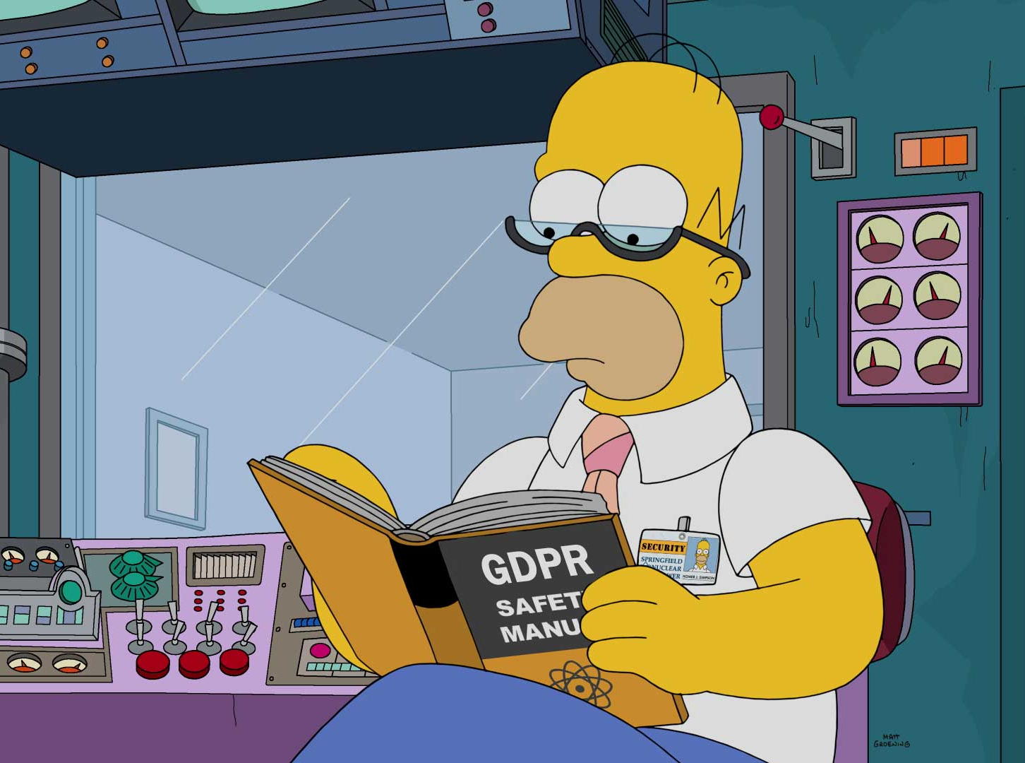
Useful Sources of Information
Diocesan website:
www.oxford.anglican.org/
(under Support Services, GDPR)
ICO Guide to GDPR: ico.org.uk
(under General Data Protection Regulation (GDPR))

Slide 22
GDPR: Journey to Compliance
22

Slide 23
Typical steps for parishes/deaneries:
Raise awareness
Conduct a Data Audit (and data mapping)
Identify (and document) your ‘lawful bases’
Check your processes meet the ‘eight rights’ and ‘seven principles’
Review how you get consent
Build in extra protection for children
Data retention and disposal
Review your Data Sharing
Update Policies & Privacy Notices
Work out how you will deal with Subject Access Requests
Data breaches: how will you detect, report and investigate?
Training
Build-in data protection to your new initiatives
rochester diocese gdpr toolkit
(simpler version at parishresources.org.uk/gdpr)
23

Slide 24
1. Raise awareness
Discuss at PCC(s), standing committee, etc.
Discuss the scope (e.g. for benefices)
Identify your legal entities (incumbent, PCCs)
24

Slide 25
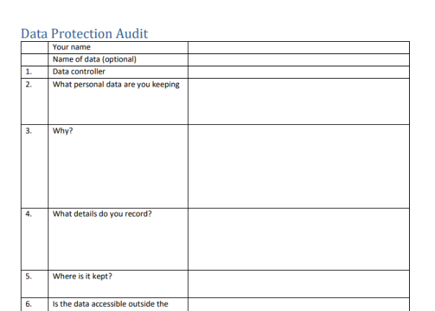
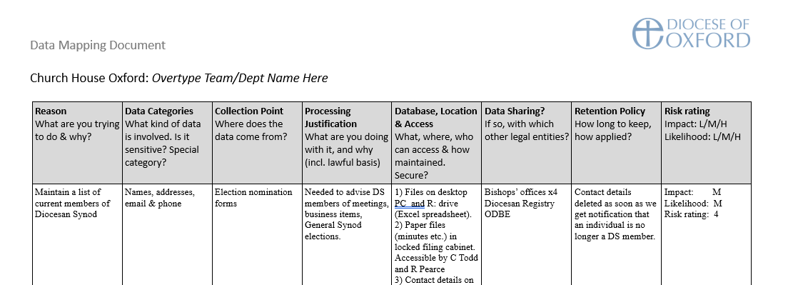
2. Conduct a Data Audit (and data mapping)
Data audit:
list all the places where you handle personal data and what is that data
Data mapping (optional next step):
helps you sort the different data into logical ‘chunks’
25

Slide 26
3. Identify (and document) your ‘lawful bases’
Legitimate interest
Contractual obligation
Legal obligation
Consent
Vital interests
Public task
Decide, in each case, which one is most appropriate.
26

Slide 27
4. Check processes meet 8 rights & 7 principles
Right to be informed (transparency)
Right of access
Right to rectification
Right to erasure
Right to restrict/suppress processing
Right to data portability
Right to object
Right in relation to automated decision-making and profiling
Processing: lawful, fair and transparent
For explicit and legitimate (limited) purposes only
Using the minimal data necessary
Kept accurate and up to date
Kept for no longer than necessary
Kept safe from corruption or unauthorised access
Data controllers: accountable and able to demonstrate compliance
27

Slide 28
5. Review how you get consent
Decide when consent is needed (part of your ‘lawful basis’ decision)
Giving consent:
  Opt-in and Opt-out: equally straightforward
  Cannot default to Opt-in
  “Granularity”: multiple Opt-ins must be separate, not linked
  Must be freely given
  Unambiguous
  Use age-appropriate language
Consent must be recorded for future reference
Withdrawing consent – must also be recorded!
28

Slide 29
6. Build in extra protection for children
Children’s personal data merits specific protection (due to increased risks)
Be clear about
  where a child is the data subject
  who gives consent for you to process data about a child?
Any privacy notice or consent statement intended to be read by children must be in plain, age-appropriate, language
Consult with children when designing processing of their data?
Consent: no set age at which children are considered competent to provide their own consent to processing (under GDPR, 13 year-olds capable of giving consent for ‘information society services’)
29

Slide 30
7. Data retention and disposal
How long do you need to keep the data?
  When do you stop using it?
  Do you need to archive it?
  Records kept for safeguarding purposes?
How you delete/dispose of it?
  Deletion of electronic records
  Regular (annual?) reviews of data e.g. of contacts in email/mobile phone
church of england records management
“Keep or Bin? The Care of Your Parish Records”
30

Slide 31
8. Review your Data Sharing
Find out which legal entities you share data with
  Who is the data controller and who is the processor?
Examine the agreement you have with them from a data perspective
  Does the agreement specify what data is shared and what the other party can and cannot do with the data
  Look for commitments that they do not share the data further
Ask them: are they GDPR compliant?
  Beware of taking ‘yes’ for an answer – probe, check their website
  Ask for a formal letter confirming that they comply (and will inform you if they cease to comply)
Do you need further work: contract amendment, data sharing agreement?
Prioritise the higher-risk organisations
31

Slide 32
9. Update Policies & Privacy Notices
Sample privacy notice:
church privacy notice for examples
  Beware of copying other peoples’ mistakes
32

Slide 33
10. Subject Access Requests
Unlikely, but could be contentious if it happens
At least have an outline plan of how you would handle a SAR
33

Slide 34
11. Data breaches
Be aware of the possibility of a data breach
Likely risk areas:
  Loss/theft of data (e.g. laptop, phone or tablet stolen)
  Email or social media account hacked
  CVs or other sensitive/confidential documents disclosed
How will you detect, report and investigate?
34

Slide 35
12. Training
What additional awareness or skills might be required?
35

Slide 36

13. Build-in data protection to your new initiatives
‘Privacy by design’: you make data protection considerations when introducing new activities and areas of involvement
Risk assess new activity (DPIAs) watch out for:
  Linked databases
  Vulnerable data subjects (elderly, children, those who are unwell)
  New technologies
36

